Slide 1
Chapter 1 - Overview
Data Structures & Algorithm in Java
Robert Lafore
Modified by Visethboti Sin

Slide 2
Group Assignments
Form a group
  Assignments
  Presentation
  Final Project
Go to Canvas, talk to your friends, go into your group on your own in "Assignment/Presentation/Project Groups"

Slide 3
Why Study Data Structure?
If you are good at data structure, you will be good at programming in a logical and efficient way (In a way that is intuitive and make sense).
Learning data structure changes the way you think, it is about solving problem efficiently.
What software companies what to see, is that you have that fundamental knowledge of programming that you can apply to their codebase that make it good.

Slide 4
Objectives of the Course
Provide background in data structures (arrangements of data in memory) and algorithms (methods for manipulating this data)
Why is this important? The answer is there is far more to programming than finding a solution that will work:
  Execution time
  Memory consumption
  Design
So, by the end of the course, you should be more equipped to not just develop an accurate solution to a problem, but try to think and find the best solution possible.

Slide 5
What is a Data Structure?
A data structure is an arrangement of data in a computer’s memory (or disk).
In short: Ways of organizing data.
Computer programs are created to process data, such as numbers or strings, and we want to do something to it to produce useful result. However, it turns out that the way we organize this data really matter a lot.

Slide 6
Think Data Structure
Questions to ponder:
  What are some examples of data structures you already know about from your Java course?
  Think of how would you organize data in your program for a student management system?
  How can the arrangement of data in memory affect performance?

Slide 7
What is an Algorithm?
An algorithm provides a set of instructions for manipulating data in structures.
In other word, It is a series of steps to perform some actions
We have an input (data), and we need to define the “steps” on how to turn this input into the desired output, these “steps” are an algorithm

Slide 8
What is an Algorithm?
It is important to design these “steps” in an efficient way
There are two thing that we care about an algorithm:
  Speed: how fast does it run?
  Memory: how much memory does it need?

Slide 9
Think Algorithm
Questions to ponder:
  What’s an example of an algorithm?
  Think about how would you go to a particular page in a book?
  How can the design of an algorithm affect performance? How can it affect memory?

Slide 10
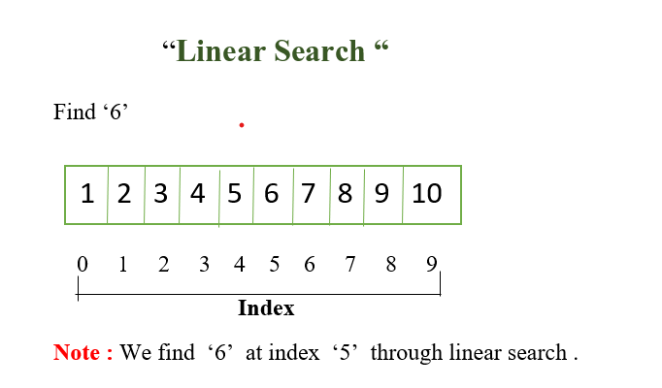
Think Algorithm – Search for a page
Brute Force Search (Linear Search):
  Start from beginning, check one by one until it is found or reach the end of the book.
  How many steps does it takes to find 6 using this method?

Slide 11
Think Algorithm – Search for a page
Any better ways than this?

Slide 12
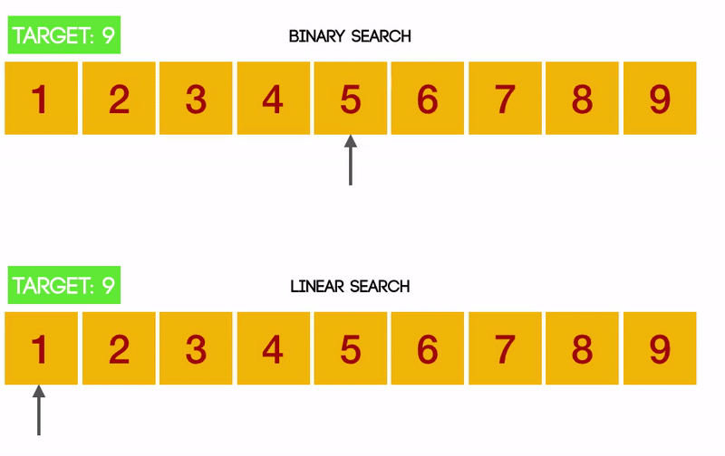
Think Algorithm – Search for a page
Linear Search vs Binary Search

Slide 13
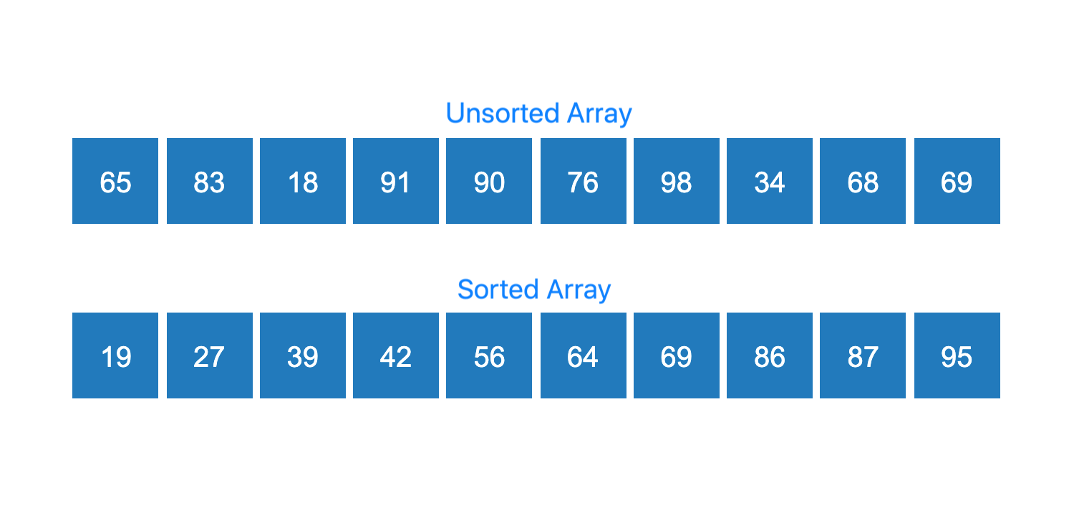
Think Algorithm – Searching from Unsorted
What if we are searching from unsorted data?
Can we use binary search? Why or why not?

Slide 14
Why study algorithms?
Computers are fast so why do we need to worry about writing efficient algorithms?
  Even with fast computation, it is not enough. Moore law vs growth of data/problem
  How much computation power and how much memory an algorithm need is very important
Designing efficient algorithm allow us to:
  Solve bigger problems
  Run faster
  Cheaper to run

Slide 15
Why study algorithms?
Computer are dumb, it can only understand the very basic of instructions, so it is crucial that we know how to efficiently give the optimal instructions.
It is very important that we design an algorithm that can achieve more by using less.
Achieve something with 10 steps is better than 100 steps.

Slide 16
Data Structure or Algorithm?
Linked List
Sort
Search
Stack
Vector

Slide 17
Data Structure or Algorithm? (Answered)
Linked List: Data Structure
Sort: Algorithm
Search: Algorithm
Stack: Data Structure
Vector: Data Structure

Slide 18
Application of Data Structure
Data Storage
Programming tool
Modeling the real world
Solve Problems / Do things for us

Slide 19
Real World Data Storage
Real-world data: data that describes physical entities external to the computer. Can we think of some examples?
What’s an example of non-computer data storage?
  Students: names, id, age, address, email, GPA
  Books: names, titles, genre
  Products: price, stock, names, suppliers
What method do these use?

Slide 20
Real World Data Storage
Say we wanted to convert one of these systems to a computer program, what must we consider?
  Memory consumption:
    how much storage do we need to store 100 books?
  Algorithms (which ones do we care about?):
    What kind of operations or actions do we need?
    Add? Delete? Search? Sort? Filter?
  Scalability:
    What about growth of storage if we need to store 1000 books?
    100 books need 10 GB, what about 1000 books?
    Linear growth? Quadratic growth?
    Same thing applied to the time complexity of the algorithms, how many steps needed to search for a book?

Slide 21
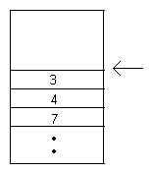
Data Structure as a Programming Tool
Not only store real-world data but perform some function internal to the machine.
Example - A ‘stack’ of data, where I can only insert or remove elements from the top:
What programmer tool would this be useful for?

Slide 22
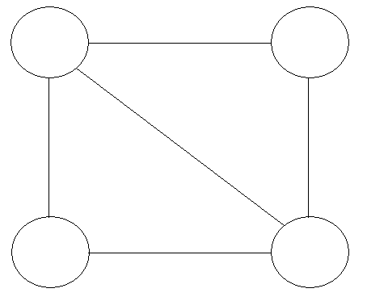
Data Structure Modeling the Real World
Effectively, ‘simulate’ a real-world situation.
For example, what could the following represent:

Slide 23
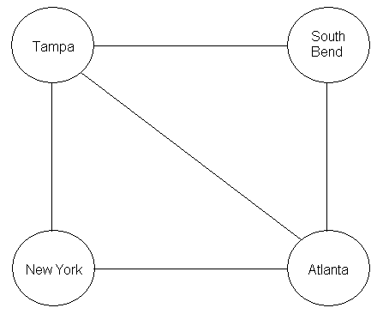
Data Structure Modeling the Real World
How about airline routes?
This type of structure is called an ‘undirected graph’

Slide 24
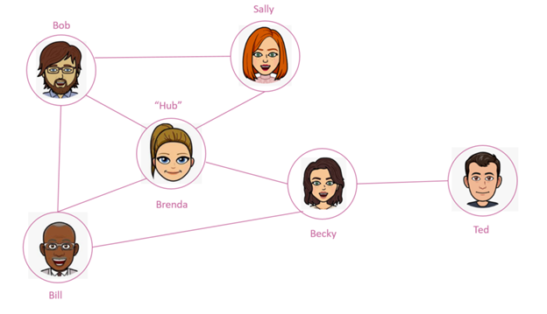
Data Structure Modeling the Real World
Another example, social networks (Facebook, Accounts...)

Slide 25
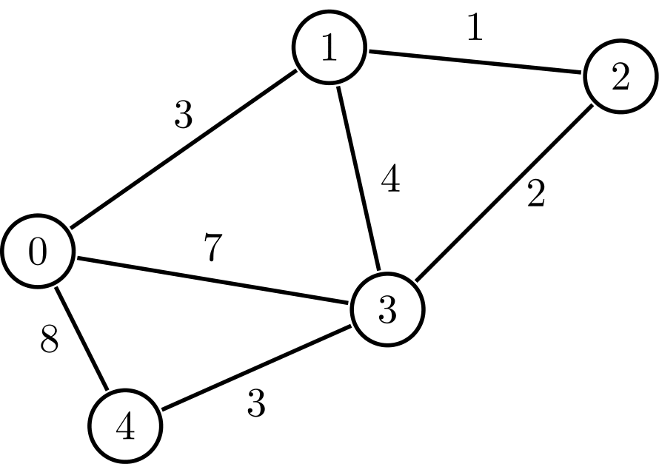
Data Structure Modeling the Real World
Weighted graph

Slide 26
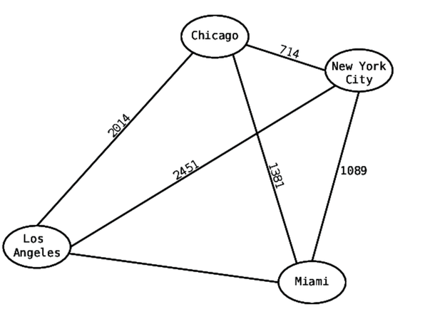
Data Structure Modeling the Real World
Modeling cities routes with weighted undirected graph

Slide 27
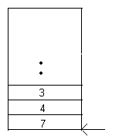
Data Structure Modeling the Real World
How about a ‘queue’ of data, where the first element in is the first element out (termed ‘FIFO’):
Example applications:
  Grocery store lines
  Traffic (Queues are actually used when determining timing of traffic lights!! How? Let’s think about it)

Slide 28
Data Structure Strengths and Weaknesses
A structure we have dealt with before: arrays
Requirement that is enforced:
  Arrays store data sequentially in memory.
Let’s name the advantages (i.e., when is an array efficient?)
Let’s name the disadvantages

Slide 29
Overall Costs for Structures We’ll Study
Structure | Access | Search | Insert | Delete | Memory
Array | Low | High | Med | High | Low
Ord. Array | Low | Med | High | High | Low
Linked List | High | High | Low | Low | Med
Stack | Med | High | Med | Med | Med
Queue | Med | High | Med | Med | Med
Bin. Tree | Med | Low | Low | Low | High
Hash Table | Med | Med | Low | High | High
Heap | Med | Med | Low | Low | High
Graph | High | High | Med | Med | Med
The point is, there is no universal data structure
Each data structure have its own strengths and weakness

Slide 30
Operations of Data Structure
In most data structure, the basic operations you can do are:
  Insert: add a new element
  Access: retrieve an element
  Delete: remove an element
  Search: find an element
These are the main operations that is performed on data also known as CRUD that stands for:
  CREATE
  READ
  UPDATE
  DELETE

Slide 31
Basic Data Structures
Array
Linked List
Stack
Queue
Binary Tree
Hash Table
Graph

Slide 32
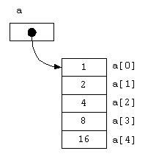
Array
An indexable continuous chuck of memory
Contain a list of elements and the size is fixed
Very fast access operation by using index and address, it access operation does not care about the size of the array. Meaning whether if it is size 100 or 1 million, the access operation still cost the same
Slow delete and search operation, why?

Slide 33
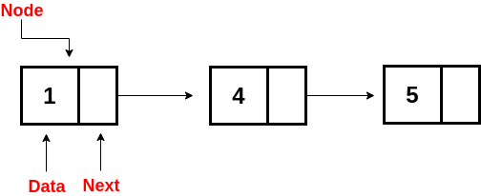
Linked List
Flexible sized list of elements, each element contain the link to the next element
The size of the linked list is flexible
Very slow access and traversing, why?

Slide 34
Stack
A collection of elements that follow the FILO (First in Last Out) principle
The last element that added to the stack is the first element that can be access from the stack
Slow access if they are searching

Slide 35
Queue
A collection of elements that follow the FIFO (First in First Out) principle
The first element that added to the stack is the first element that can be access from the stack
Slow access if we are searching

Slide 36
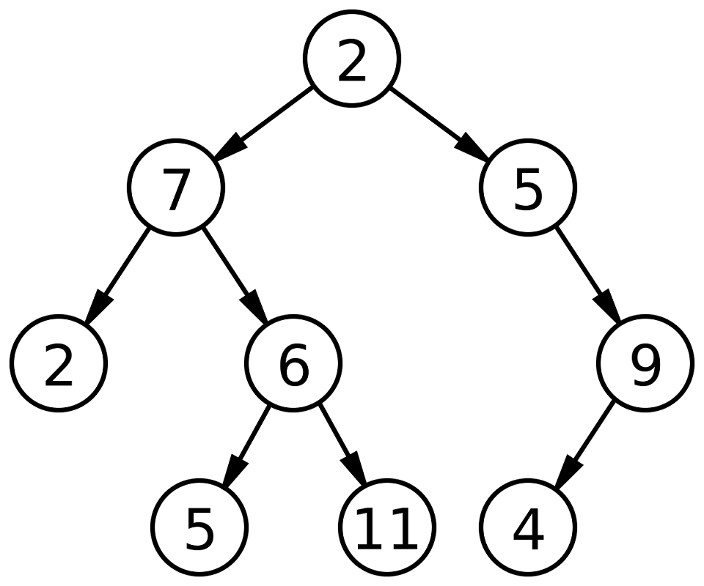
Binary Tree
A tree data structure with at most two children's nodes
High memory usage
Fast search and add

Slide 37
Basic Algorithms
Brute-Force Search
Binary Search
Sort
Breadth First Search
Shortest paths

Slide 38
Brute Force Search
An algorithm that access every single possible elements of a data structure to find a specific element. It go through each element one by one until the target is found.
Also known as exhaustive search or generate and test
Very expensive
If the element it searching for does not exist in the data structure, then it need to go through everything

Slide 39
Binary Search
An algorithm to search a sorted data structure, it compares the target value to the middle element of the array
Considered to be the best performing search algorithm
Can only be use on a sorted array or list
In most case when use, need to sort an array with a sorting algorithm first before using this algorithm to search

Slide 40
Sorting
Sorting algorithm is used to sort a data structure
There are many different sorting algorithms:
  Selection Sort
  Bubble Sort
  Insertion Sort
  Merge Sort
  Heap Sort
  Quick Sort
  …

Slide 41
Breadth First Search
A search algorithm for tree data structure, its goal is to find whether a particular node with a value exist in a tree.
Explores all nodes at the present depth before moving to the next depth until the node is found
This algorithm is very memory intensive since it need to maintain information on all node it went through
It is slow when there are many nodes at each depth

Slide 42
Shortest Path Algorithms
Algorithms to find the short paths in a graph data structure
Many algorithms:
  Dijkstra's Algorithm
  Bellman-Ford Algorithm
  A Search Algorithm*
Applications such as GPS navigation, network routing, and resource allocation problems

Slide 43
More Algorithms
Evolutionary/Genetic Algorithms for combinatorial optimization
Kahn's Algorithm for Topological sorting
Huffman Encoding for data compression
Hierholzer's algorithm for Eulerian path
Prim's Algorithm for Minimum Spanning Tree
...etc

Slide 44
Conclusion
Data Structures and Algorithms are fundamental to computer science.
Programming is just making use of data structures and algorithms
Understanding data structures and algorithms enables us to write efficient and optimized code.
Same result can be achieving with different solution, it is important we design the best possible solution.
Typically, the most efficient solution in computer science would be the cheapest in term of time and memory.
They are commonly used in interviews and real-world projects.

Slide 45
Conclusion
Data Structures are ways of organizing data
An algorithm is a sequence of well-defined steps
The relationship between data structures and algorithms is that algorithms operate on data structures
It is important to choose the right data structure and the right algorithm for the problem
The selection is situation-dependent based on the nature of the problem.

Slide 46
Conclusion
Every data structure possesses unique strengths and weaknesses.
They excel in performing certain operations while struggling with others. For example, array performed really well at accessing but poorly at other operations such as deleting and searching
Understanding these characteristics is crucial because it enables you to select the most suitable data structure for a particular problem.
The aim is for you to produce high-quality performance code, if not the best performing code possible.
This is why we should learn data structure and algorithm.

